Slide 1
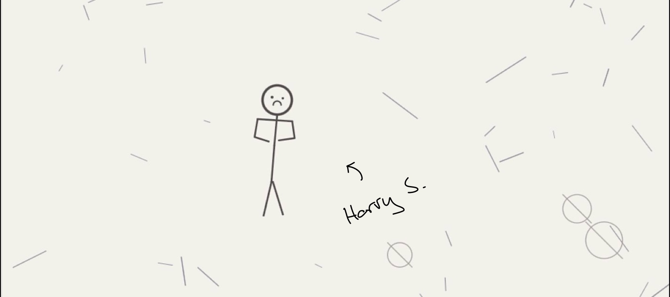
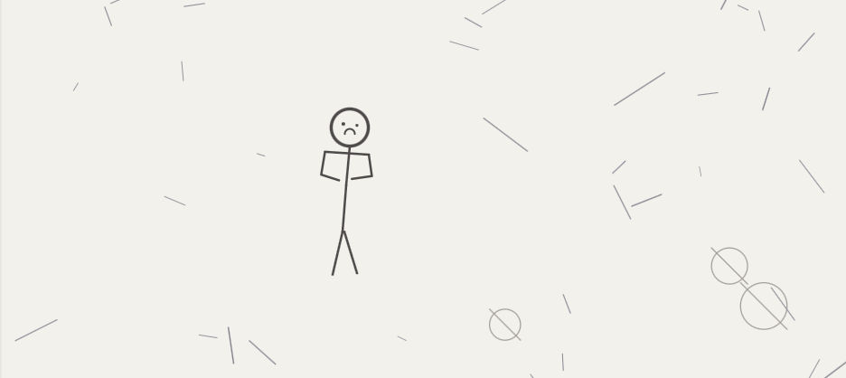
TRUMAN
If the amount of time we spend with AI will only increase, why not make those interactions meaningful?

Slide 2
“draw yourself”
If the amount of time we spend with AI will only increase, why not make those interactions truly meaningful?

Slide 3
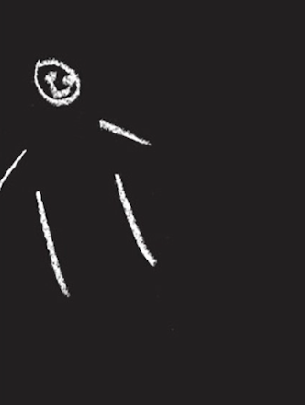
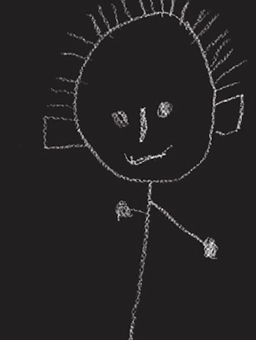
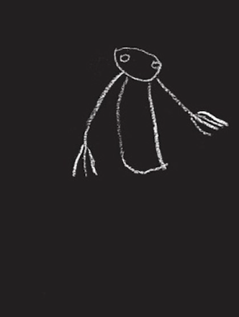
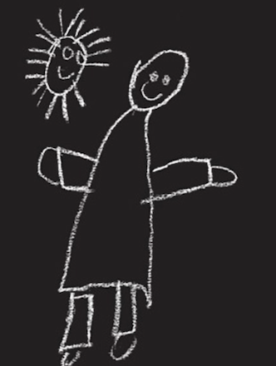
“draw yourself”
children

Slide 4
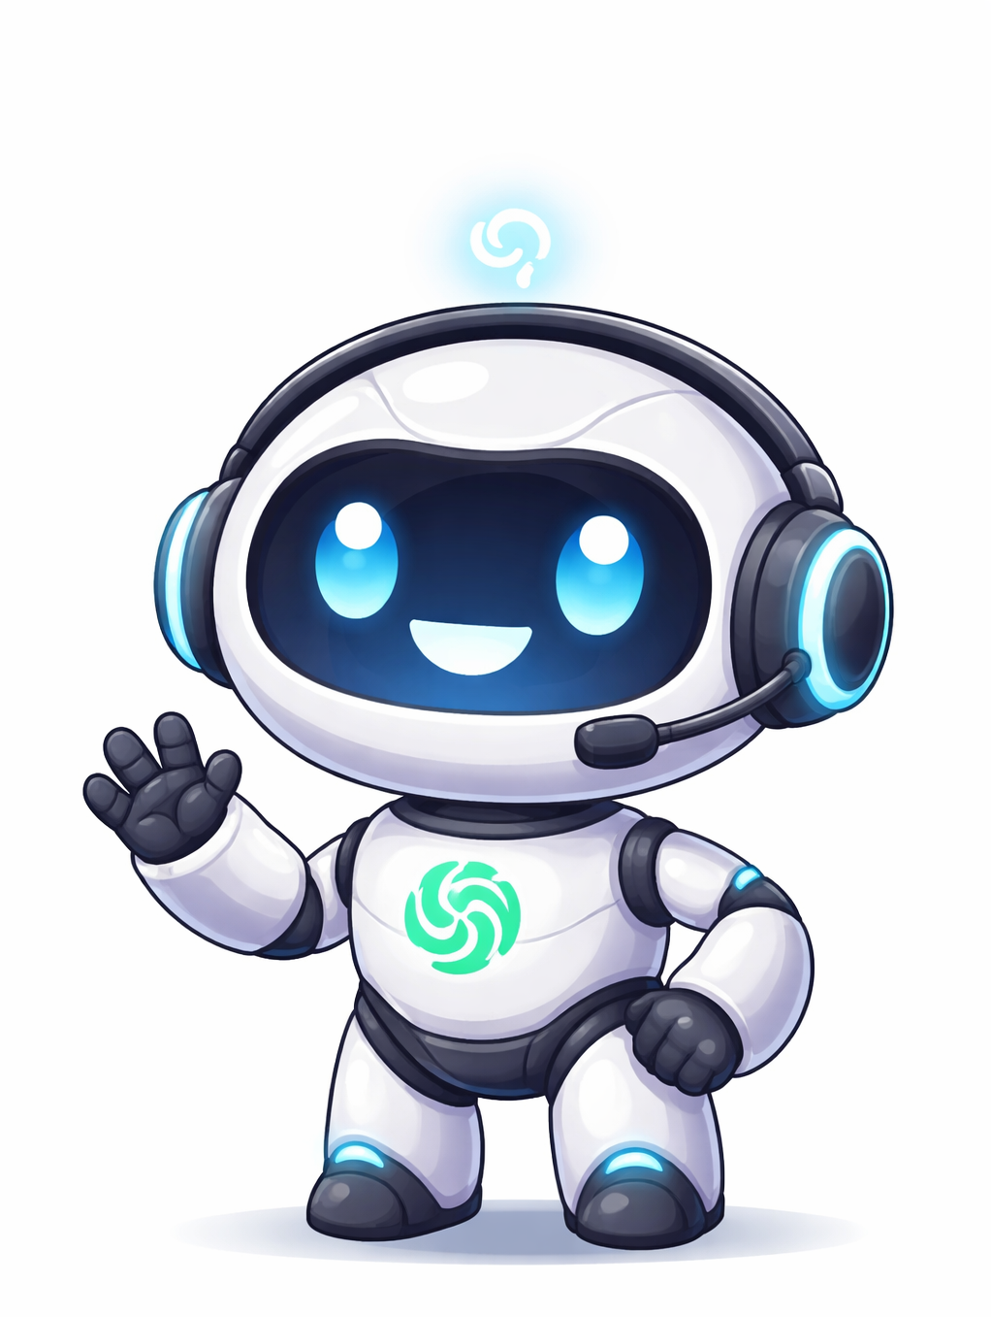
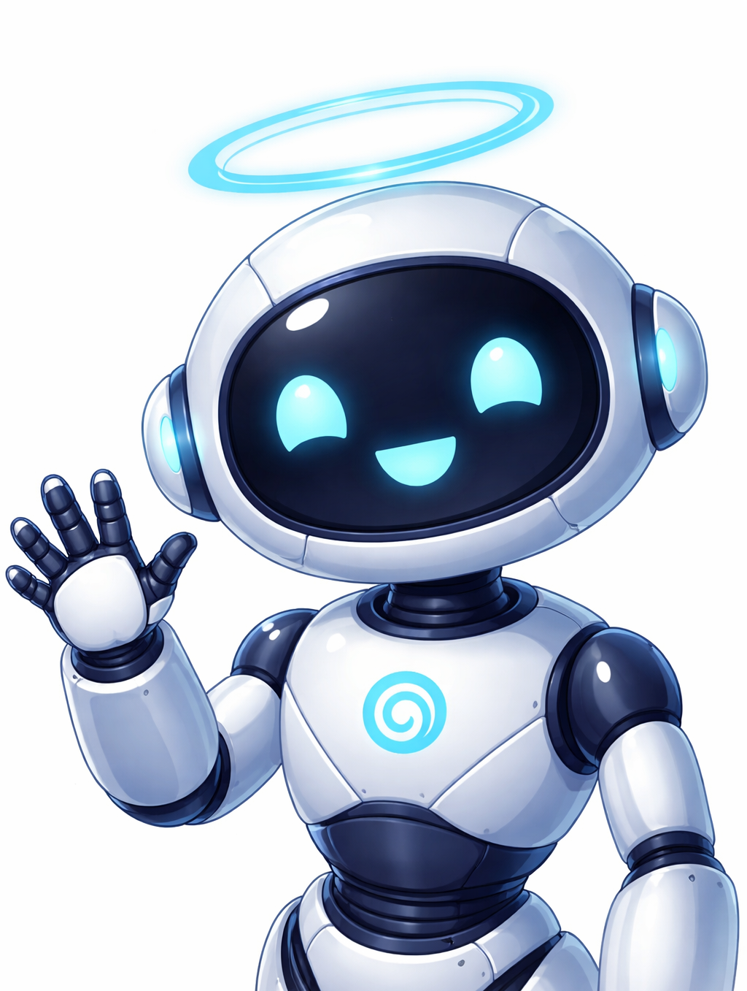
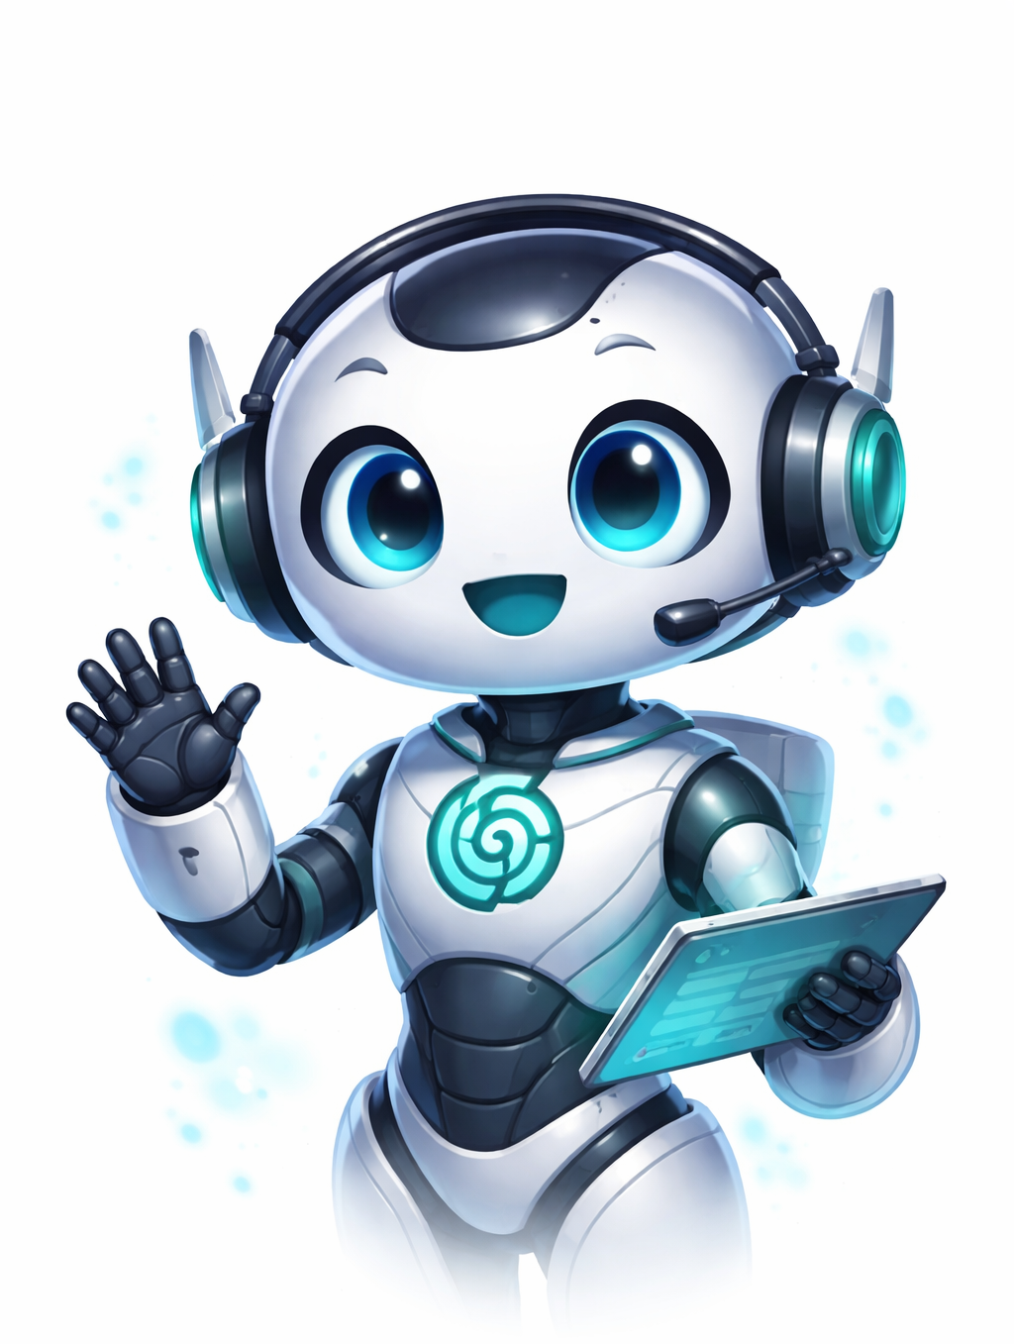
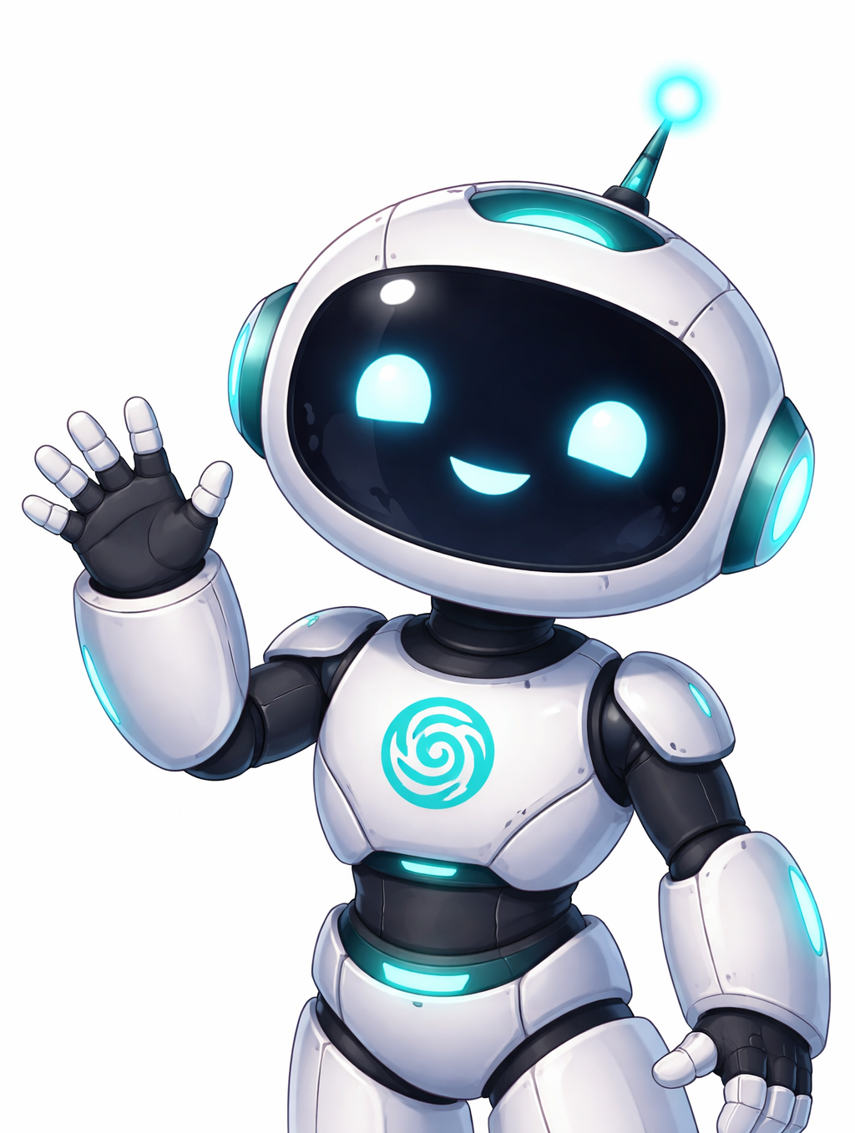
“draw yourself”
children
ChatGPT

Slide 5
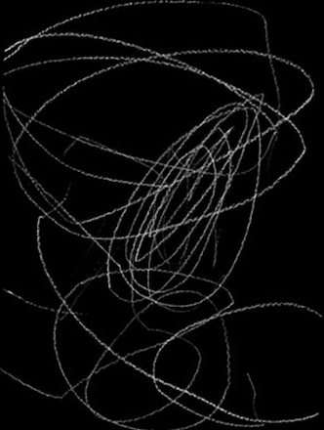
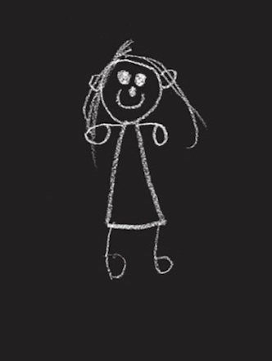
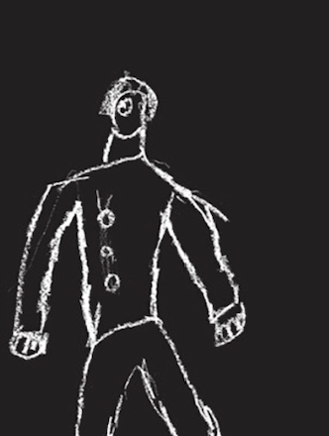
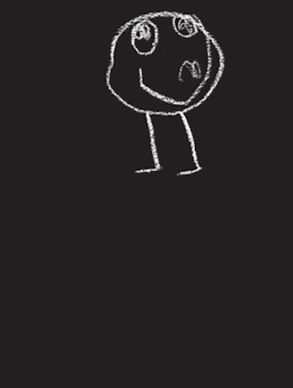
“draw yourself”
children
ChatGPT
our turn

Slide 6
“draw yourself”
children
ChatGPT
our turn
ARCHITECTURE
latent gaussian vector
mean = trait direction
variance = trait stability

Slide 7
“draw yourself”
character prior
scraped from great literature, e.g. Dostoevsky, Kafka, Austen
ARCHITECTURE
latent gaussian vector
mean = trait direction
variance = trait stability

Slide 8
“draw yourself”
ARCHITECTURE
character prior
scraped from great literature, e.g. Dostoevsky, Kafka, Austen
latent gaussian vector
mean = trait direction
variance = trait stability

Slide 9
“draw yourself”
ARCHITECTURE
character prior
scraped from great literature, e.g. Austen, Kafka, Dostoevsky
RL environment (our little Truman world)
generated, non-deterministic social-situation
latent gaussian vector
mean = trait direction
variance = trait stability

Slide 10


“draw yourself”
ARCHITECTURE
character prior
scraped from great literature, e.g. Dostoevsky, Kafka, Austen
RL environment (our little Truman world)
generated, non-deterministic social-situation
coherence
latent gaussian vector
individuality
=
mean = trait direction
variance = trait stability
random noise

Slide 11
ARCHITECTURE
character prior
scraped from great literature, e.g. Dostoevsky, Kafka, Austen
RL environment
generated, non-deterministic social-situation
If the amount of time we spend with AI will only increase, why not make those interactions truly meaningful?
coherence
latent gaussian vector
individuality
=
mean = trait direction
variance = trait stability
random noise

